Slide 1
When was the last time someone asked you how Happy You Are?

Slide 2

How
Happy
Is The World?
A Data Storytelling Project

Slide 3

Meet Our Team Group 21
Vatsal M Tailor
Neantha Louiza Vaz
Palak Nath
Aditya Bansal

Slide 4
How Do We Quantify Happiness?
Notes:
We start off our presentation with a basic question, How do we quantify happiness. ? Or the question should be, can we actually measure happiness ? Apparently we can. Although there are many ways to measure happiness, for eg - self reports, surveys, questionnaires, but the question of happiness here is so subjective that we need some common determinants to measure it. Hence we have the World Happiness report to measure it.

Slide 5

World Happiness Report
First published in April 2012
Publication of Sustainable Development Solutions Network
Factors considered to evaluate happiness: Mutual trust among people, Freedom, Health, generosity and absence of government corruption
150+ countries surveyed year after year
Notes:
But first let us introduce what the world happiness report is?

Slide 6
Why this Topic?
This year marks the 10th anniversary of the World Happiness Report, which uses global survey data to report how people evaluate their own lives in more than 150 countries worldwide. The World Happiness Report 2022 reveals a bright light in dark times. The pandemic brought not only pain and suffering but also an increase in social support and benevolence. As we battle the ills of disease, it is essential to remember the universal desire for happiness and the capacity of individuals to rally to each other’s support in times of great need.
Notes:
Pandemic took a toll on each of our lives . People were not only affected health wise, many people lost their livelihood, were forced to relocate, lost their loved ones etc.

Slide 7

Objective
🙂 Understanding determinants used to calculate Happiness Index
🙂 What happened to the overall happiness index during COVID?
🙂 How did the determinants change during COVID?
🙂 Understanding what happened to Happiness index post prime COVID duration.

Slide 8
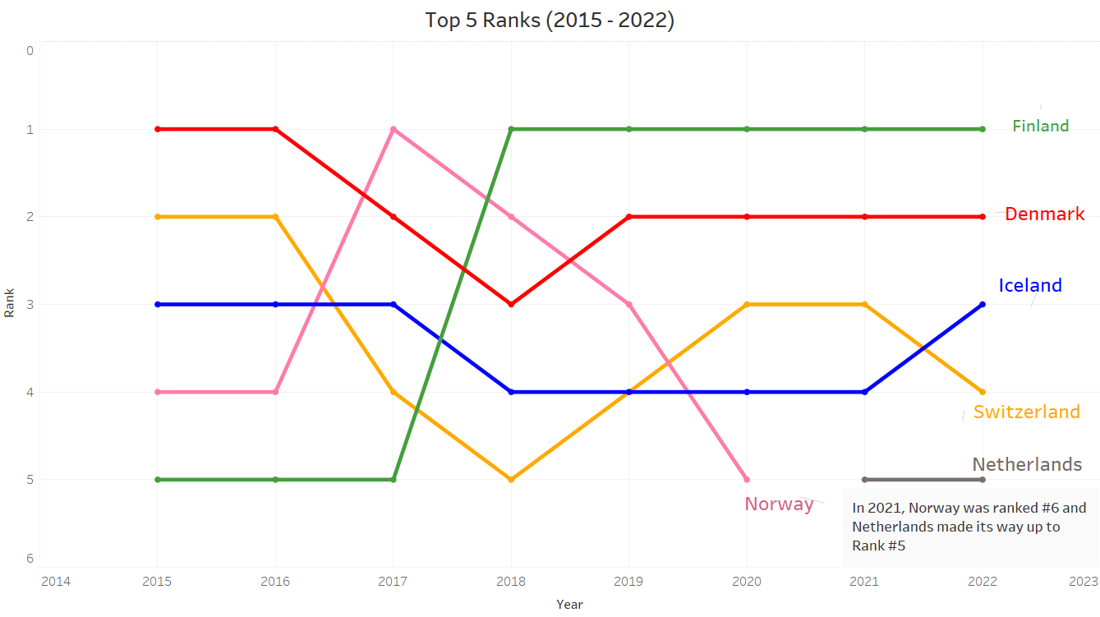
Notes:
Make the audience note that the same countries have occupied the top 5 ranks over the last few years. We see just one new country break into the top 5 in the recent years. Norway dipped down in happiness index, reason being 7% of the total Norway population was infected by covid by then.

Slide 9
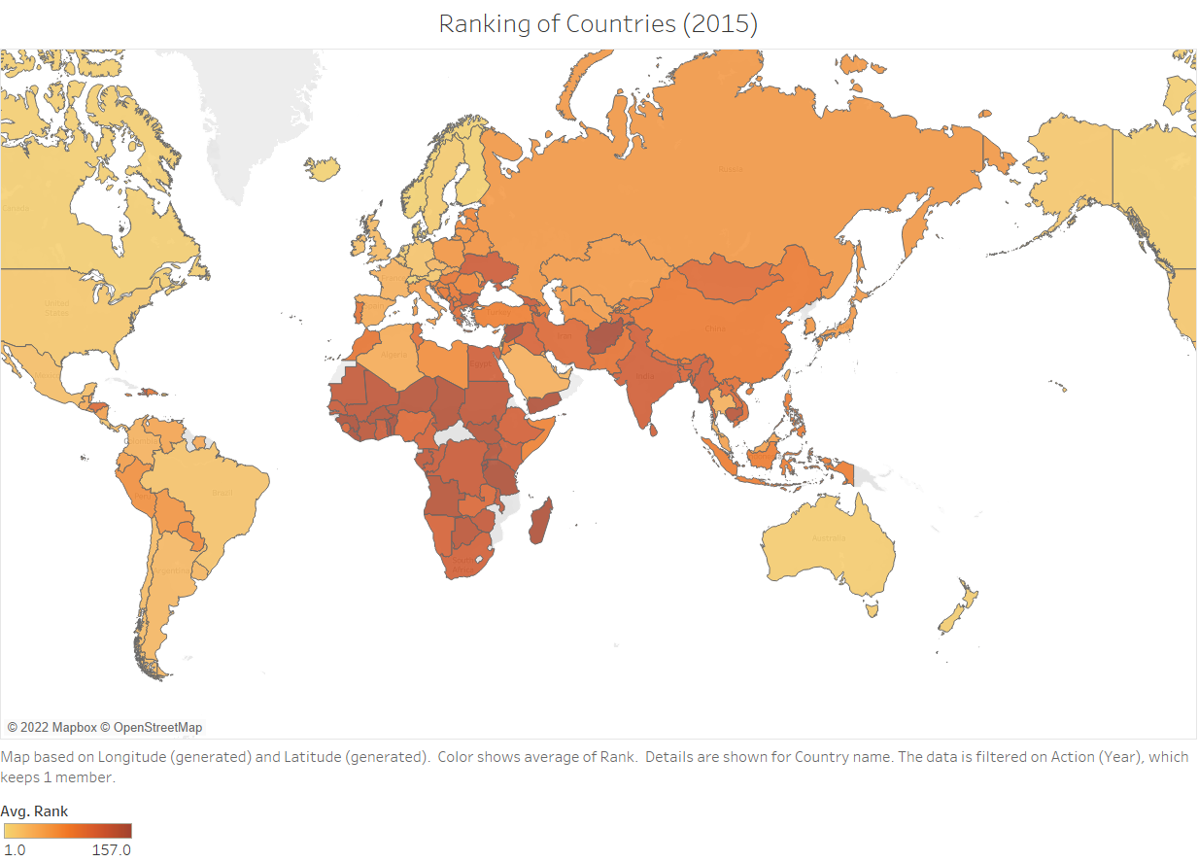
Notes:
The lighter the countries, the happier they are!

Slide 10
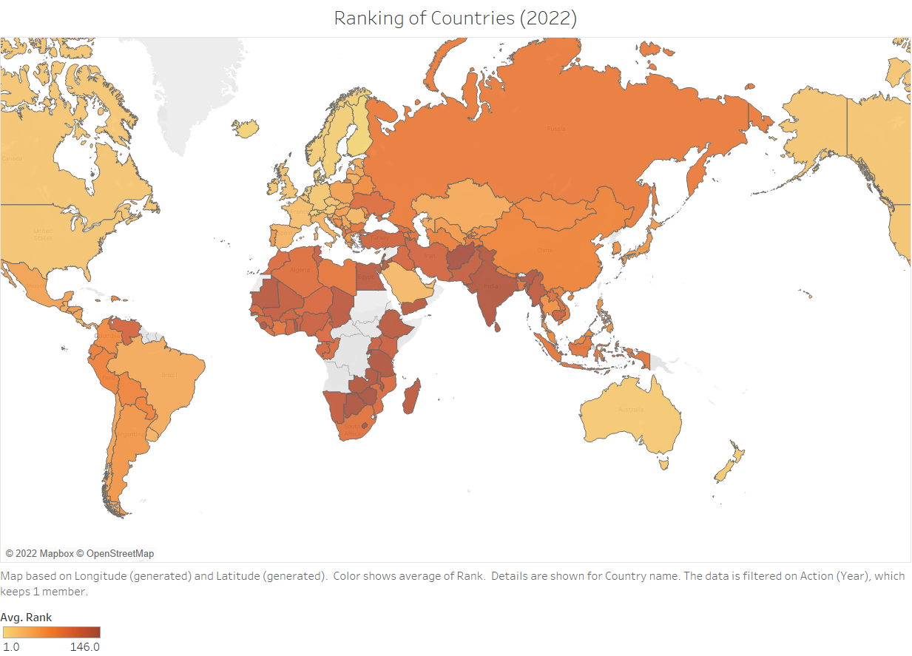
Notes:
One point to be noted here : Most countries in the African and the Asian continent are constantly ranked amongst the worst countries. At the same times, countries in the

Slide 11
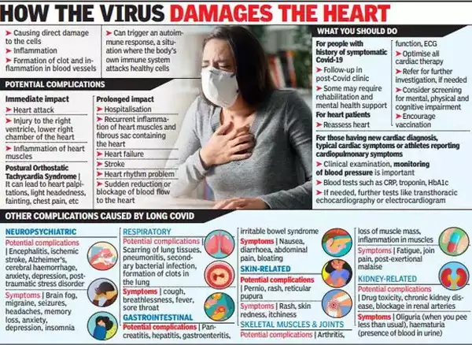
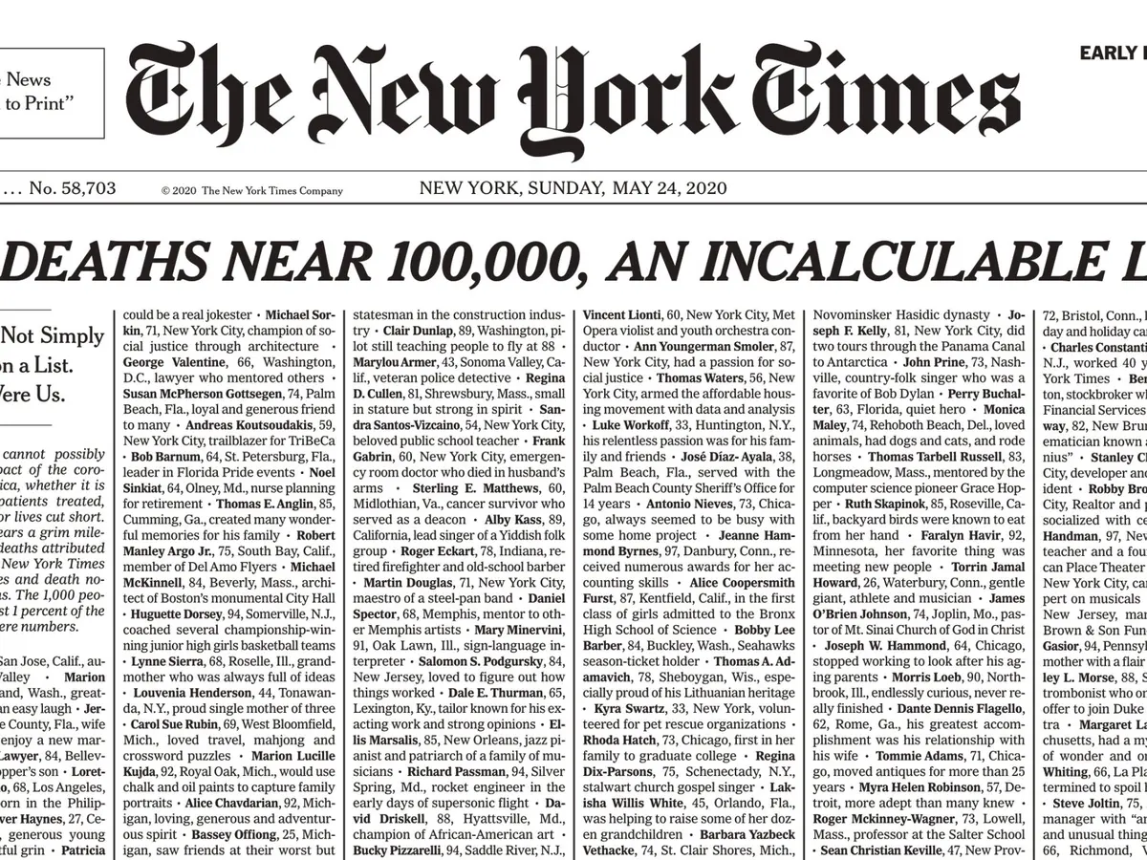
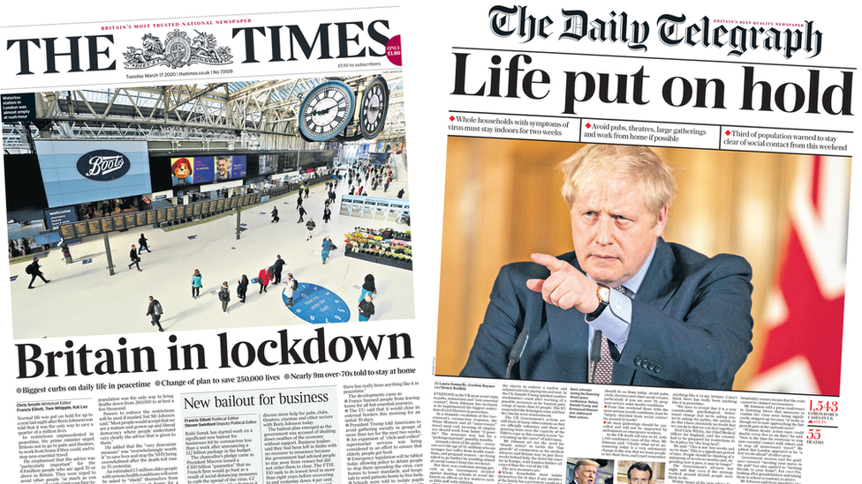

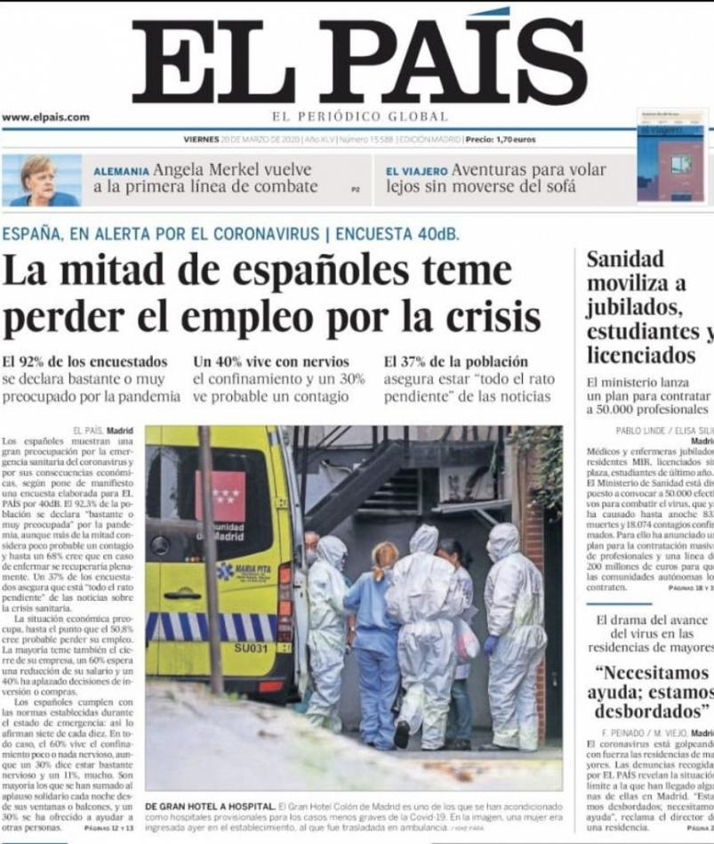
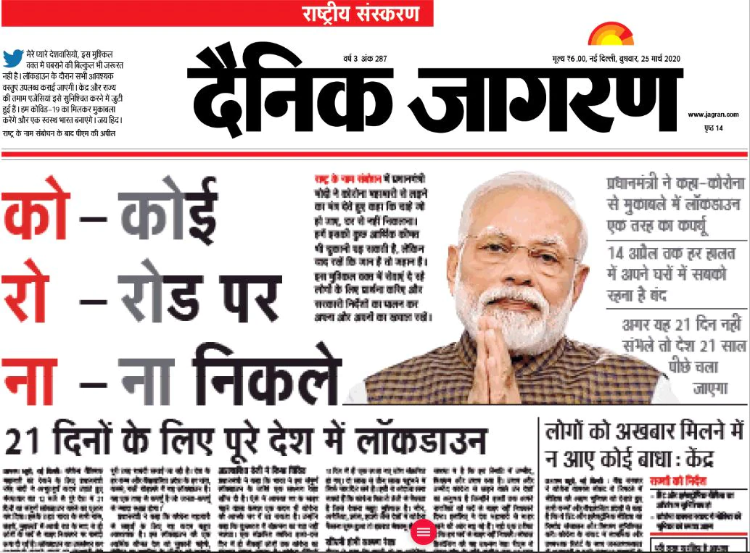
Notes:
During the pandemic people were flooded with tons of negative news on a daily basis.

Slide 12
Did the Pandemic have an effect on how people perceived Happiness?

Slide 13
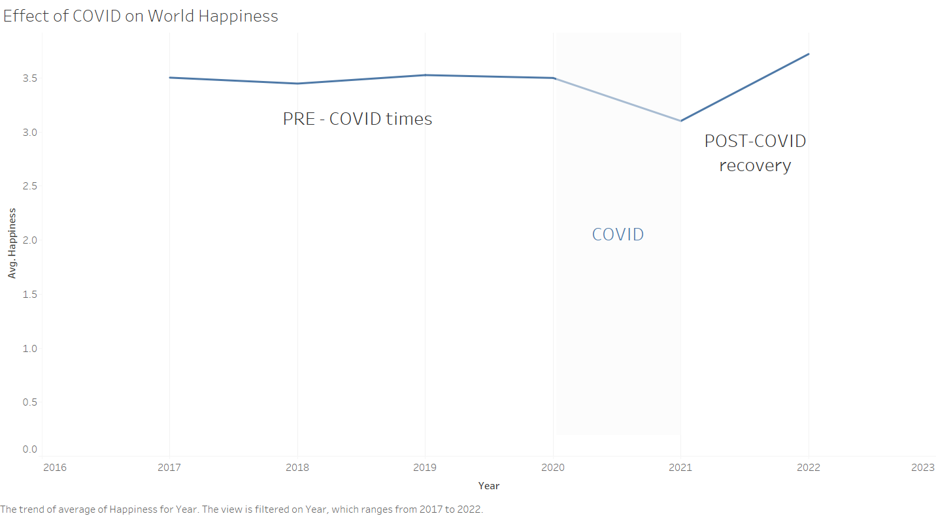
Notes:
Here we have plotted the World Avg.Happiness trend over the past years. We notice that the happiness index have remained the same in 2017-2019 , a flat trend. But then covid came! A dip in happiness. Happiness is now increasing in the POST COVID recovery, and it is thus shooting over the previous levels of happiness. The world seems more happy than what is was before! (since being locked for more than 1 year, people have realised the importance of going out and socializing)

Slide 14
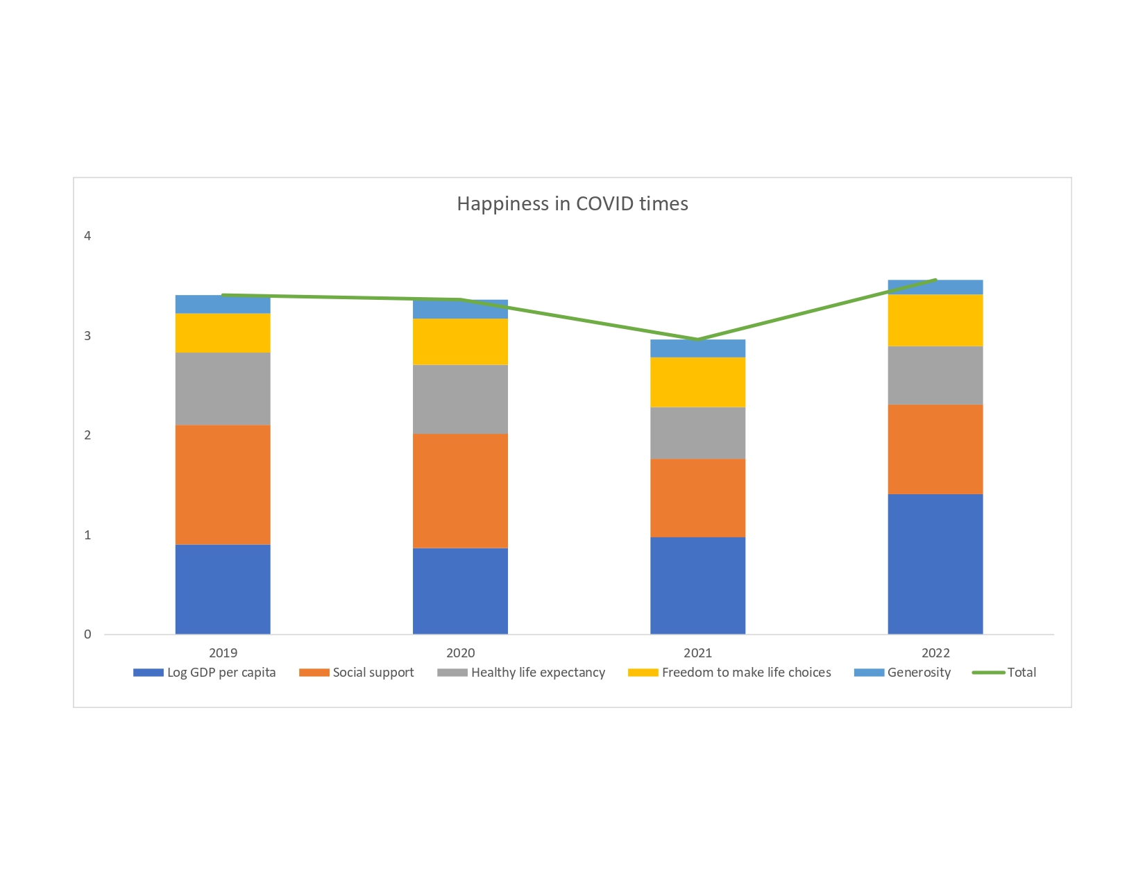

Slide 15
Let’s explore the factors that affect the Happiness according to the World Happiness Report

Slide 16
Key determinants for Happiness Report
Corruption
Perception
Freedom
of Life Choices
Social
Support
Perception Survey
Life Expectancy at Birth
GDP
Per Capita
Government and Country Statistical Survey
Generosity
Self Reported Behaviour
Notes:
That affects

Slide 17
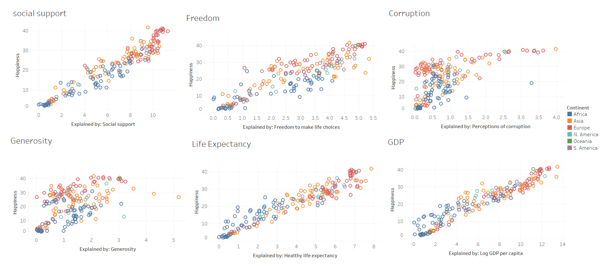

Slide 18
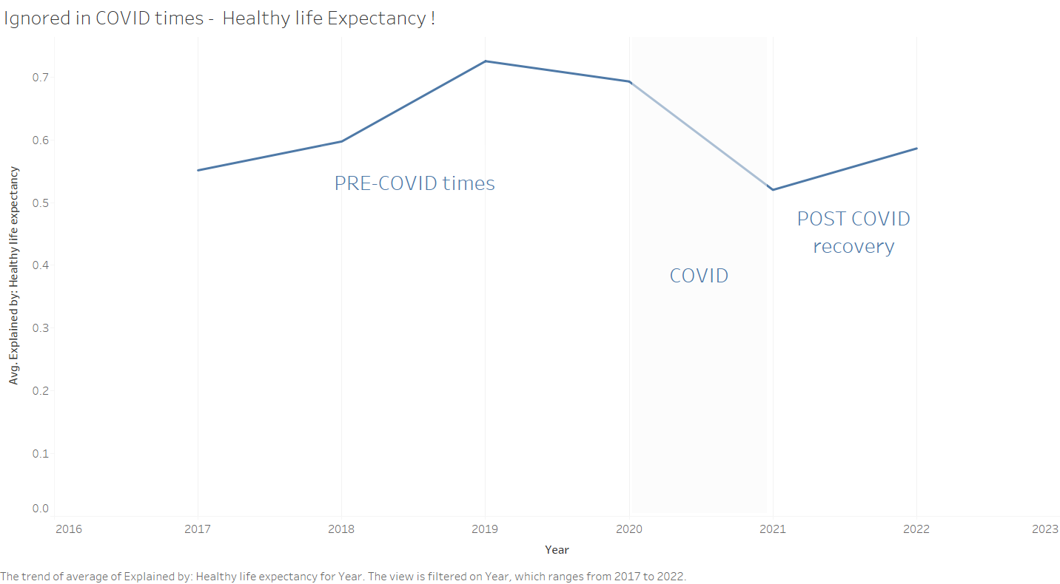
Notes:
COVID saw losses of many human lives, and affected more lives in a serious manner. It stretched our health care infrastructure to its limits. We see a surprising fact here, People PREFER to stay HAPPY. They know that Life Expectancy is affected by COVID, and have preferred to stay happy by being insensitive to the Health Life Expectancy!

Slide 19
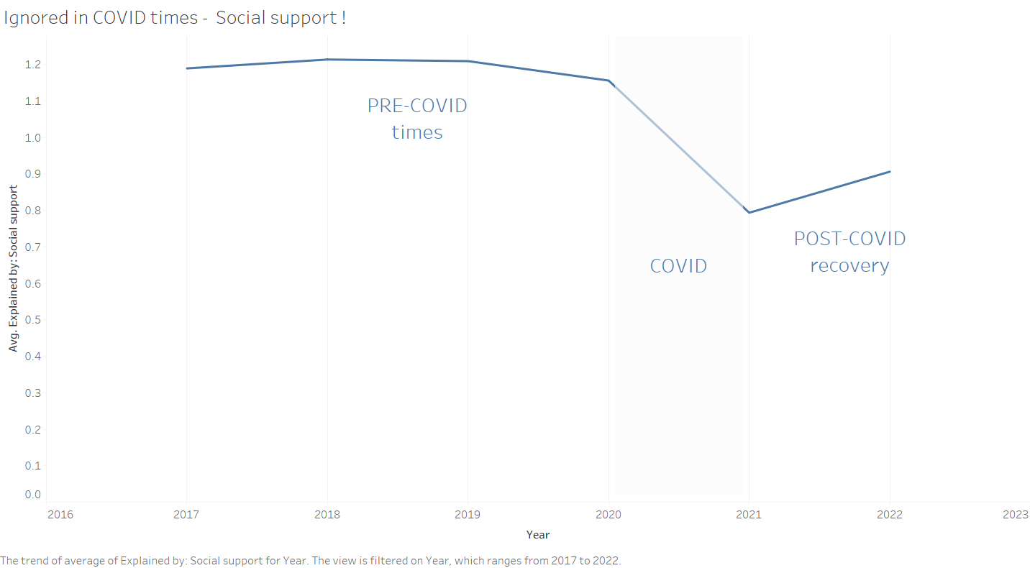
Notes:
This is natural and to be expected. Social and Physical contact, Going out and meeting new people is limited hugely due to COVID. People thus now pay less heed to social support during COVID. But the trend is increasing.

Slide 20

CAN MONEY BUY HAPPINESS???

Slide 21
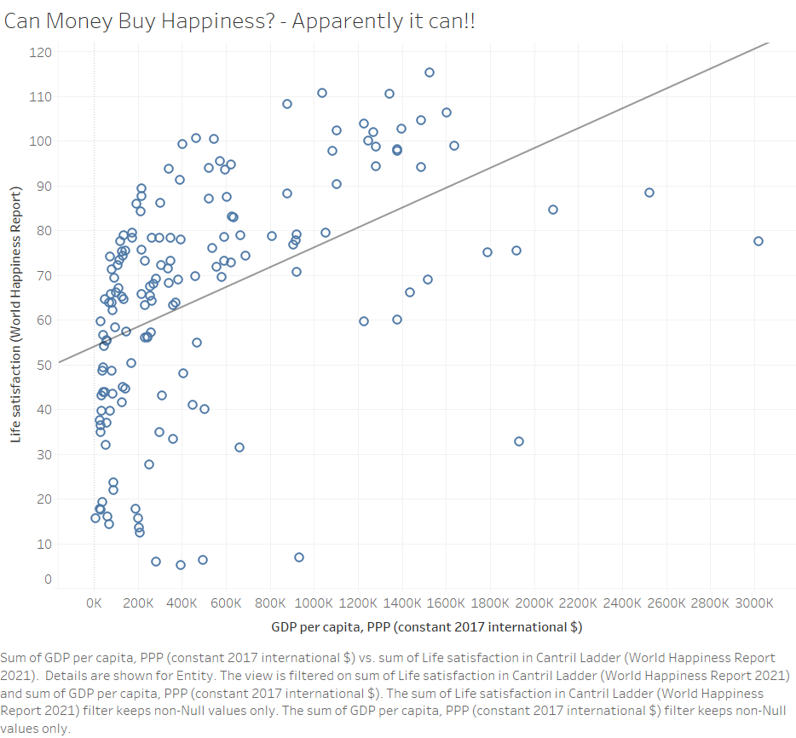
GDP per capita, PPP
Notes:
Sum of GDP per capita, PPP (constant 2017 international $) vs. sum of Life satisfaction in Cantril Ladder (World Happiness Report 2021). Details are shown for Entity. The view is filtered on sum of Life satisfaction in Cantril Ladder (World Happiness Report 2021) and sum of GDP per capita, PPP (constant 2017 international $). The sum of Life satisfaction in Cantril Ladder (World Happiness Report 2021) filter keeps non-Null values only. The sum of GDP per capita, PPP (constant 2017 international $) filter keeps non-Null values only.

Slide 22
Closing Remarks
Happiness is defined by different people in different ways. When we feel positive emotions we tend to feel happy. That is what happiness is all about. Happiness is also regarded as the mental state of a person in an optimistic manner. However, the world happiness report doesn’t take into account some very important factors like mental health, population

Slide 23

In a world full of competition, where everyone is technically in a race, running after materialistic gains, next time stop and ask someone how happy they are ?

Slide 24
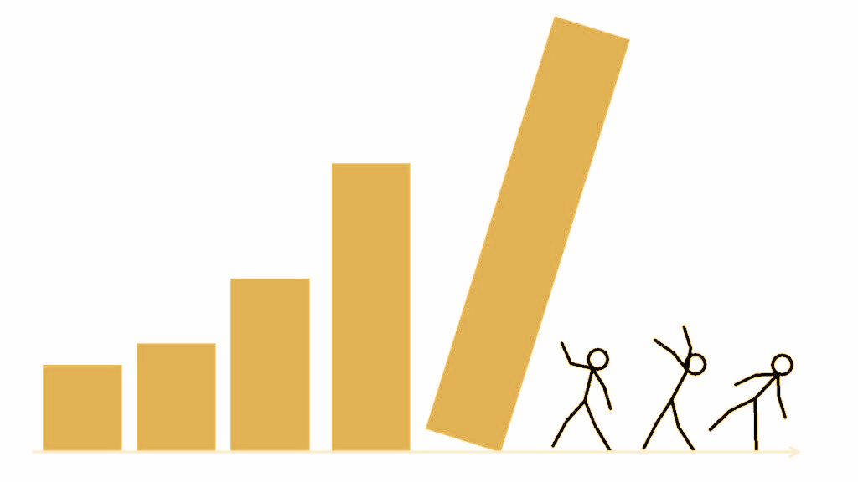
Questions?

Slide 25
References
https://www.economicsobservatory.com/what-can-we-learn-from-the-latest-worldhappiness-report
https://worldhappiness.report/ed/2021/happiness-trust-and-deaths-under-covid-19/
https://www.unsdsn.org/
Finland Is Again the World's Happiest Country, Report Finds - The New York Times (nytimes.com)
https://www.bloomberg.com/news/articles/2022-03-18/world-s-happiest-ranking-goes-tofinland-for-fifth-year-in-a-row
https://saas.berkeley.edu/rp/world-happiness-report-eda%23:~:text=The%20report%20uses%20six%20key,corruption%20in%20business%20and%20government.%E2%80%9D&text=Here's%20a%20slice%20of%20the%20table

Slide 26
THANK YOU !

